Slide 1
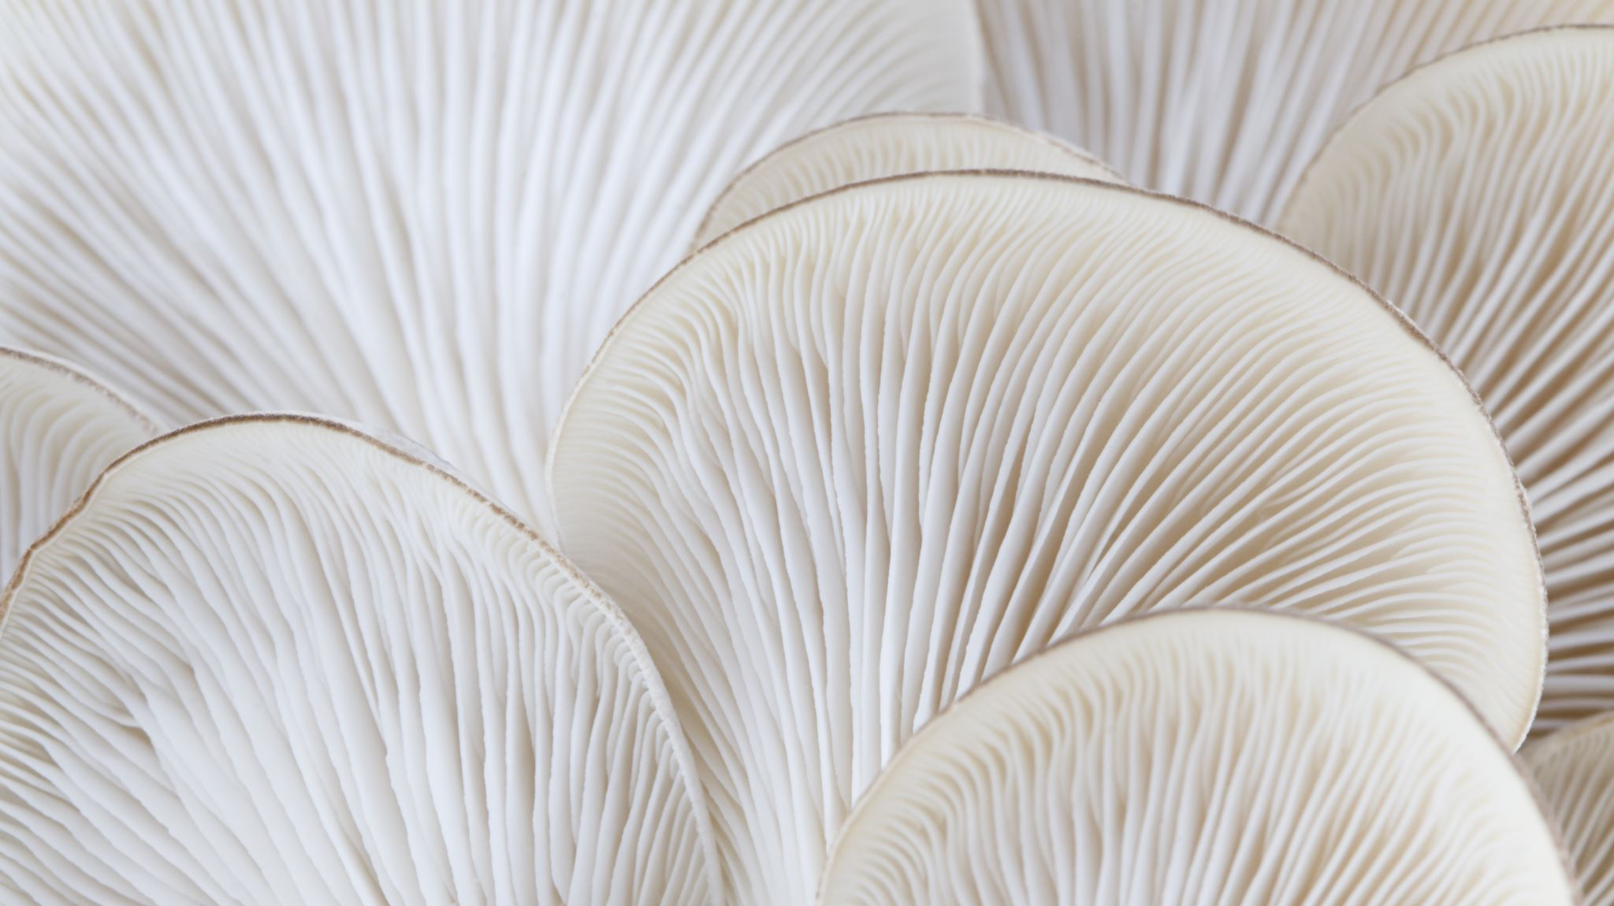
Mushroom Classification
Dominic Familette
Elvis Mitropoulos
Karthika Prasad
Nayoung Kim

Slide 2
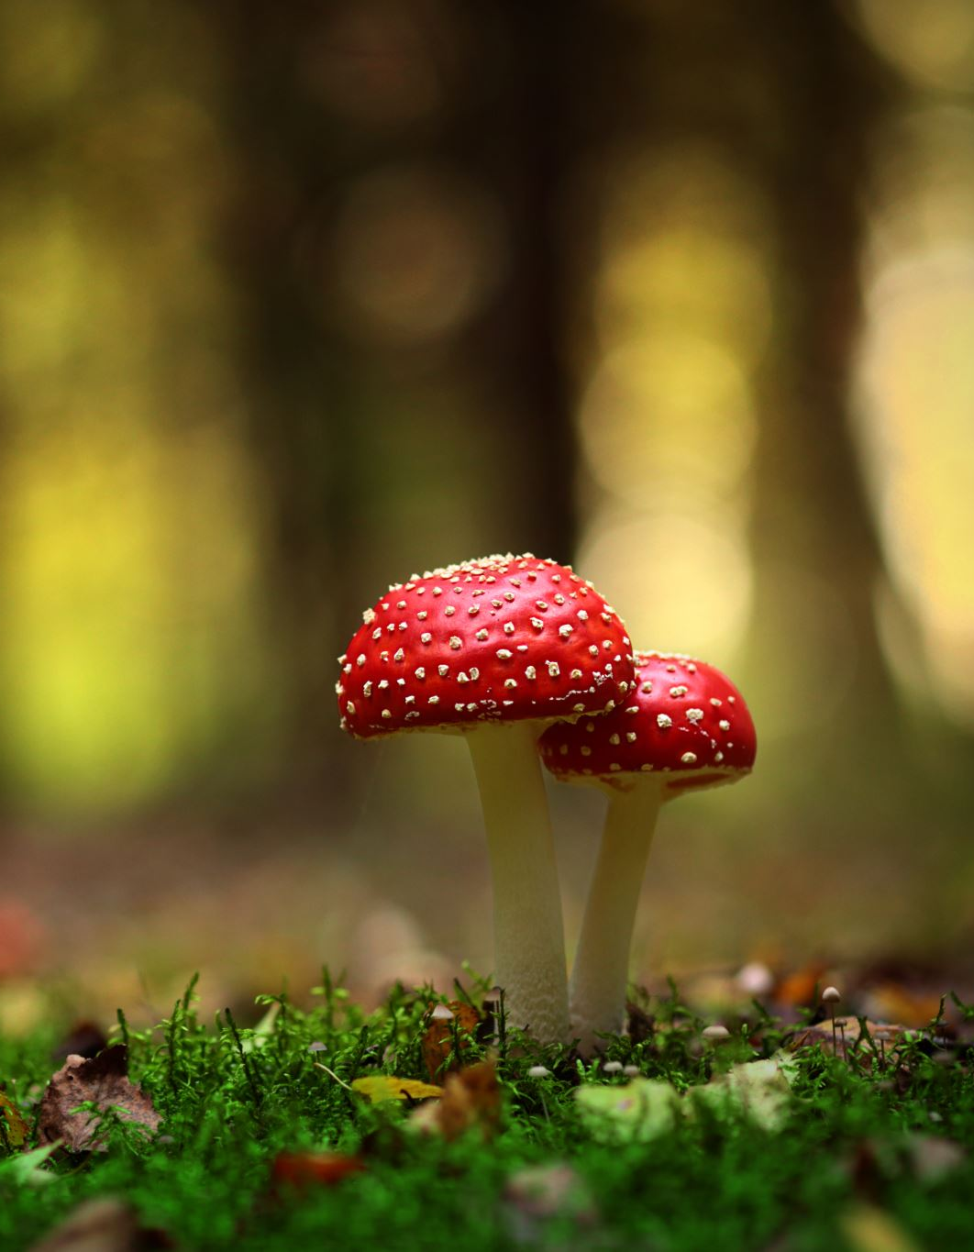
Mushrooms Dataset
Kaggle (https://www.kaggle.com/datasets/uciml/mushroom-classification/data)
Why?
Develop a model to classify poisonous/edible mushrooms given their features (i.e. veil color, gill size, bruises, and ring type)
Shape
8143 data observations of mushrooms
22 features variable that describe mushrooms
1 target variable that classes mushrooms – edible vs. poisonous.

Slide 3
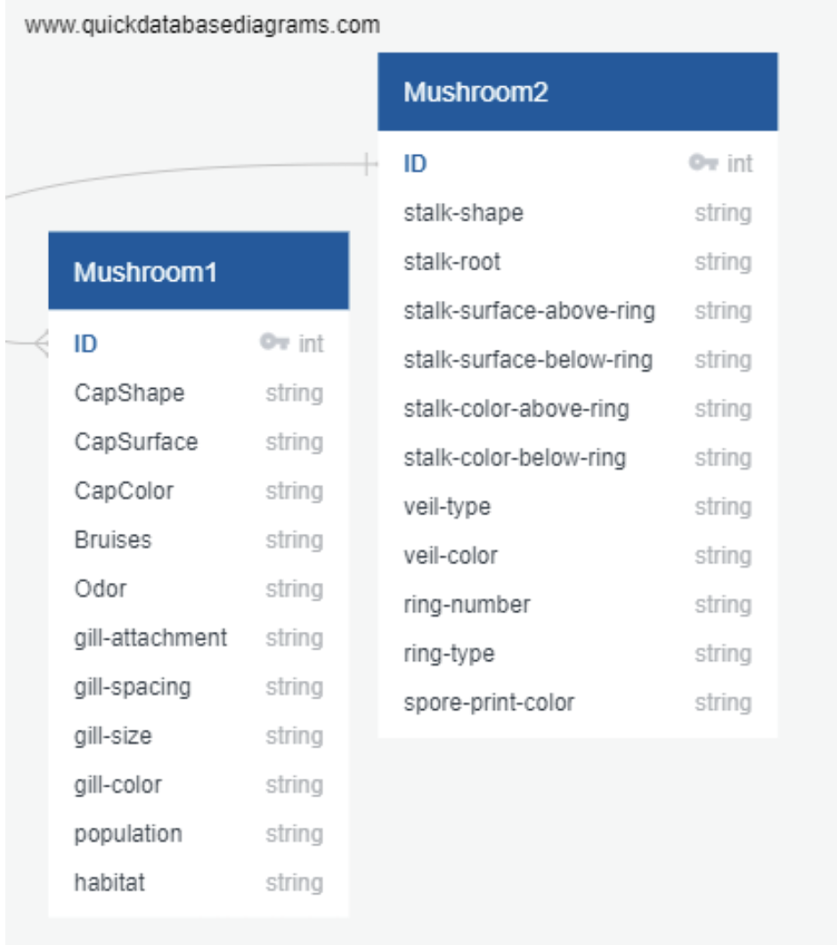
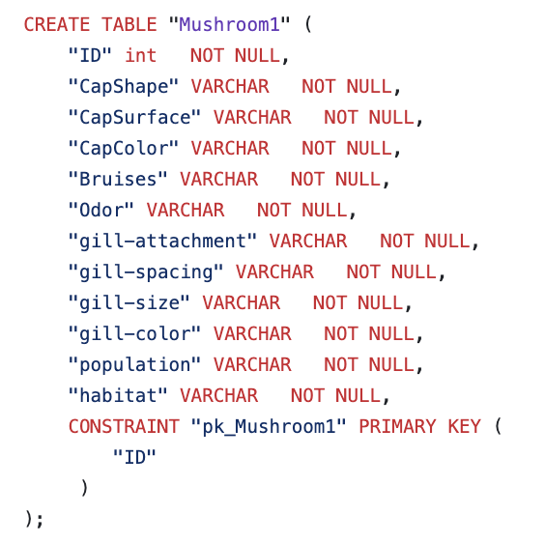
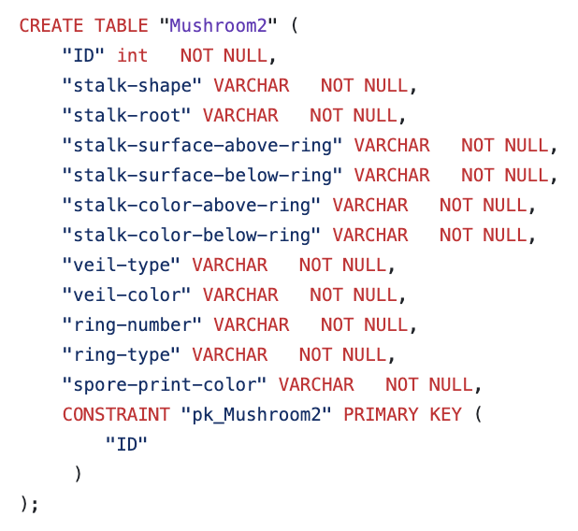
QuickDBD & PostgreSQL
Used Quick Database Diagrams
Created two tables in PostgreSQL

Slide 4
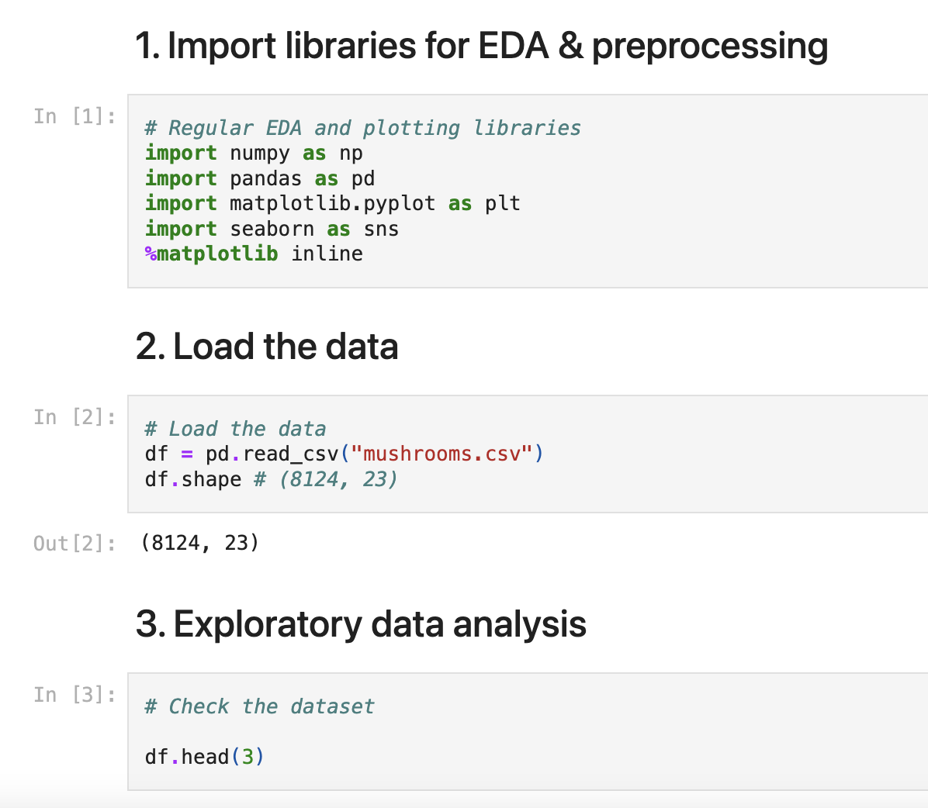
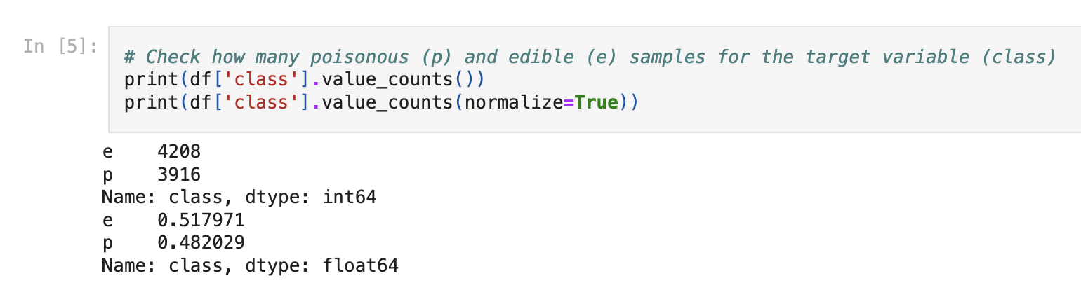
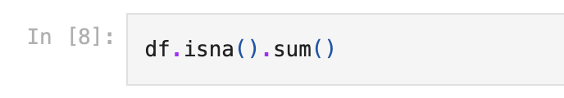
ML Modeling Framework EDA & Preprocessing
Import libs, load, and check the data shape.
Check NA values and the categories for each feature variable
Check to see if the target variable is balanced between two classes

Slide 5
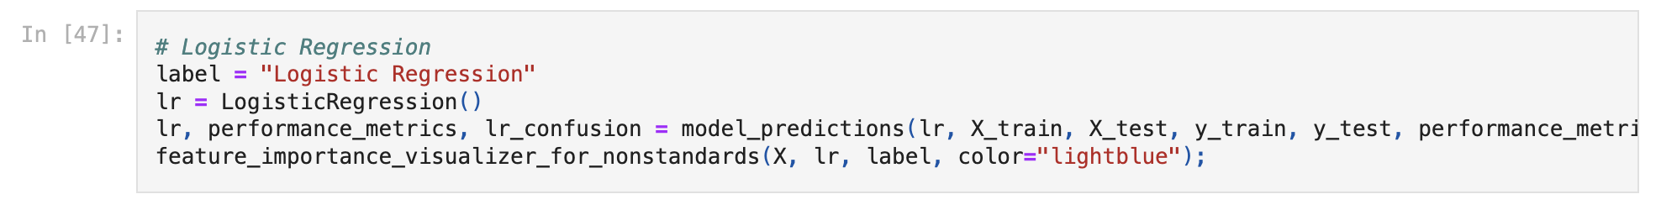
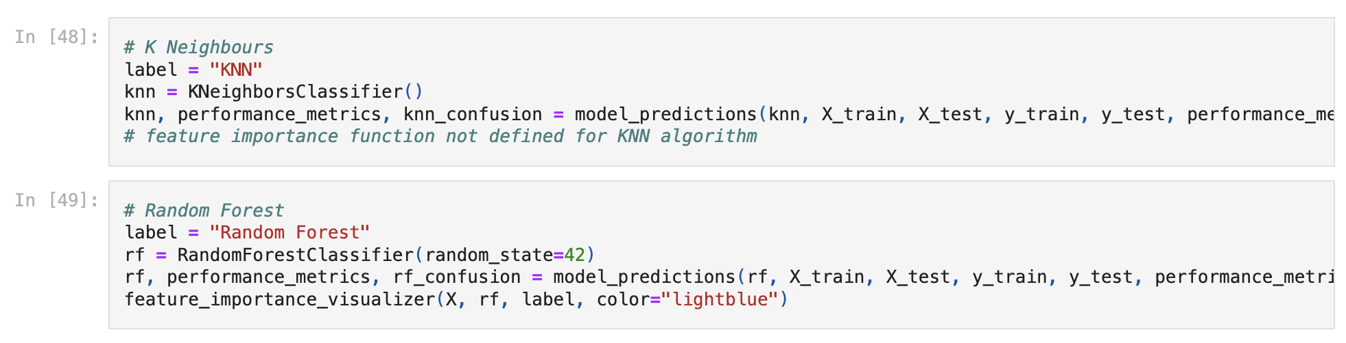
ML Modeling Framework Model Training
Model training
Logistic Regression with LogisticRegression()
K-NEarest Neighbors with KNeighboursClassifier()
RandomForest - RandomForestClassifier()

Slide 6
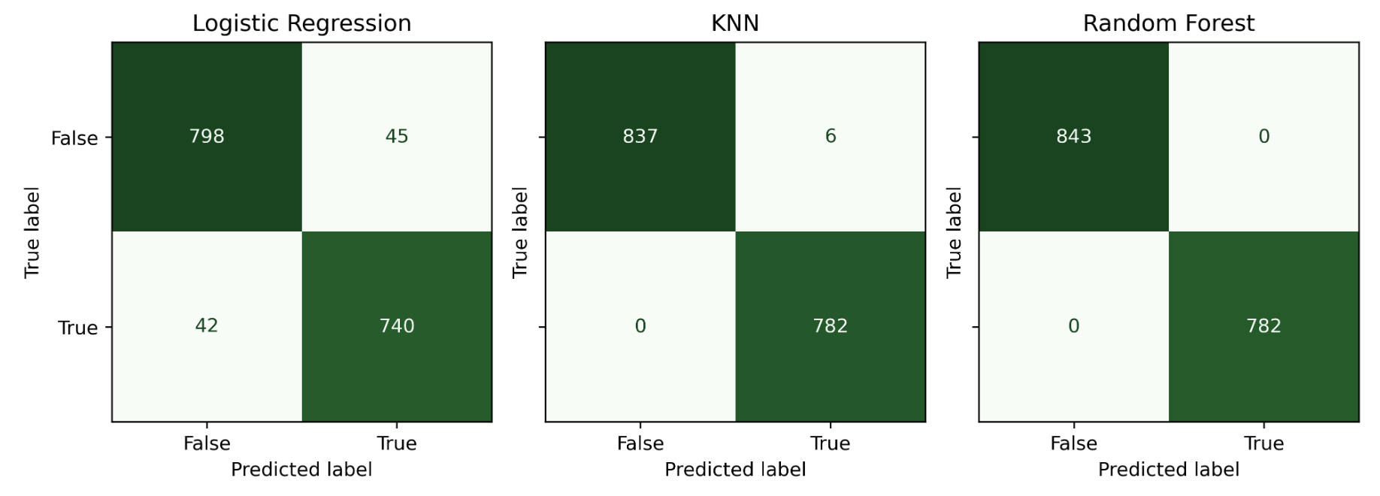
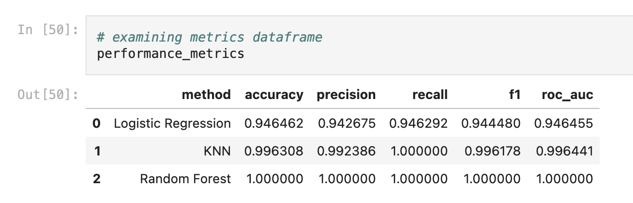
ML Modeling Framework Model Evaluation
Confusion Matrix
Accuracy
Precision
Recall
F1
ROC_AUC

Slide 7
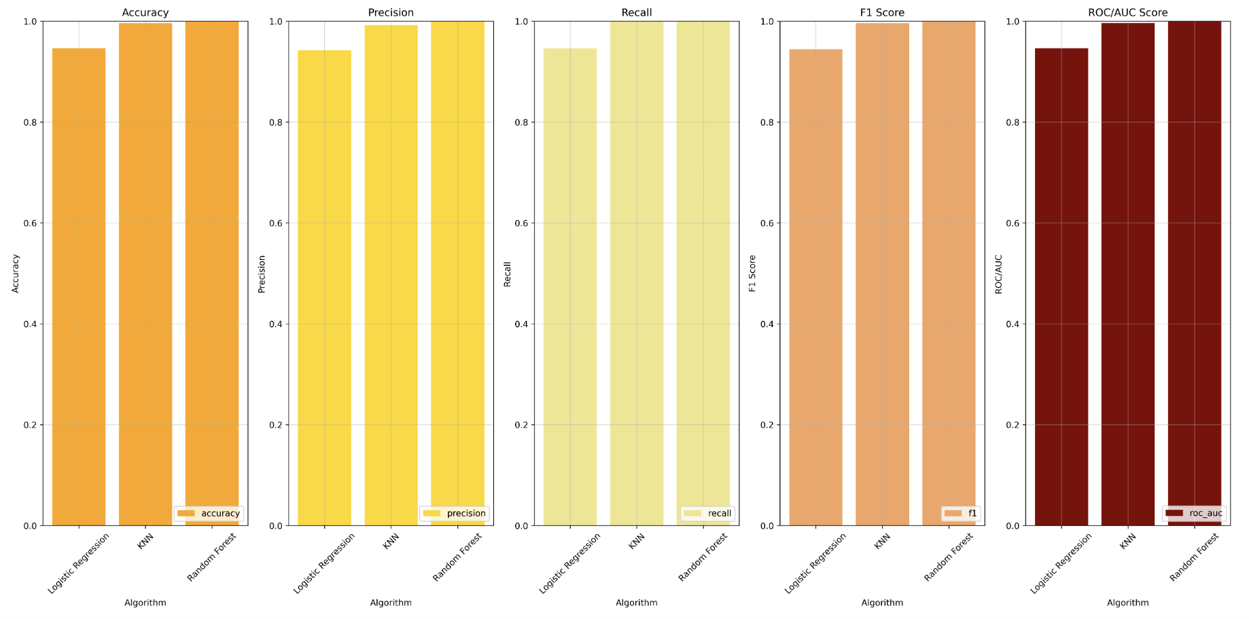
ML Modeling Framework Model Evaluation
Confusion Matrix
Accuracy
Precision
Recall
F1
ROC_AUC

Slide 8
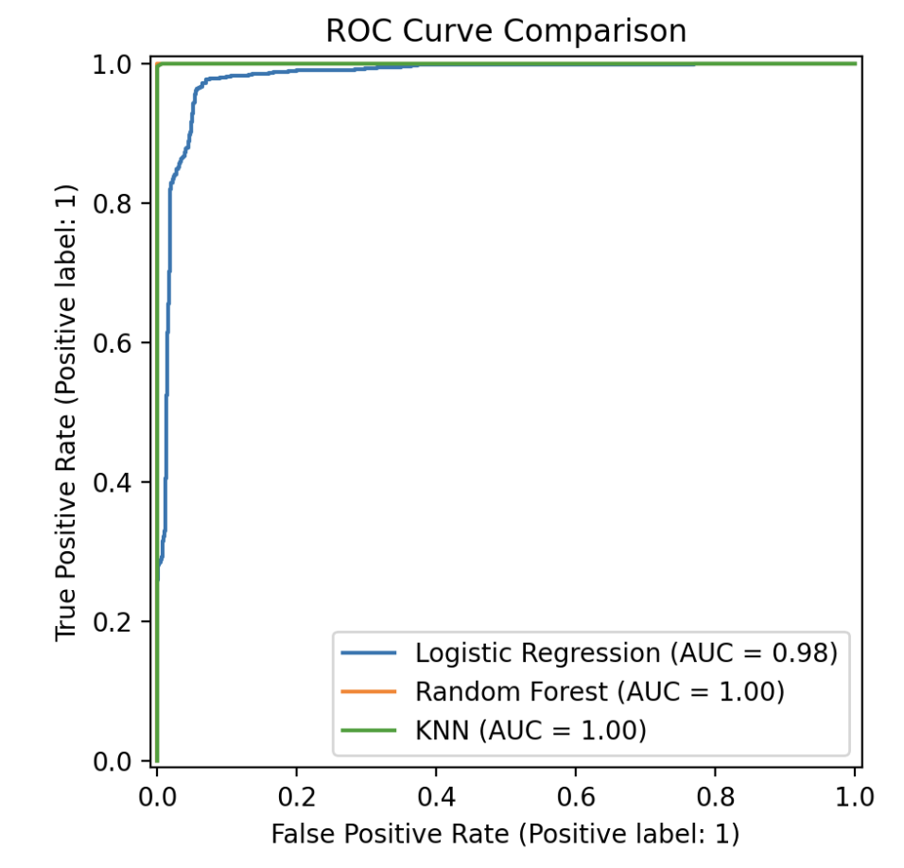
ML Modeling Framework Model Evaluation
Confusion Matrix
Accuracy
Precision
Recall
F1
ROC_AUC

Slide 9

Mushroom Classification Website
Tech Stack
Frontend: HTML, CSS, JavaScript
Backend: Flask (Python)
Model: K-Nearest Neighbors (KNN)
Frontend Development
Create user interface with dropdowns for mushroom attributes
Use CSS for styling and responsive design
Implement JavaScript for dynamic form population and handling user input
Backend Development
Set up Flask server to handle requests
Load pre-trained KNN model
Define routes for home page and prediction endpoint
Data Processing
Map user inputs from dropdowns to corresponding numerical values
Prepare data for prediction model
Prediction
Send user inputs to Flask server
Use KNN model to predict if the mushroom is edible or poisonous
Display prediction result on the web page
Deployment
Deploy the web application on a cloud server
Ensure the application is accessible and functional

Slide 10
Thank you! ☺

